Slide 1
연구개발 일지
2023
이강우
ETRI

Slide 2
Common
Point, Size2d, Box, BGR, Image, Frame
Camera 관련
Camera(I), ImageCapture(I)
ImageProcessor, FrameProcessor(I)
Object detecting 관련
Detection, ObjectDetector(I), DetectingProcessor(→FrameProcessor)
Object tracking 관련
ObjectTracker(I), ObjectTrack, TrackState, TrackProcessor
TrackingPipeline(→FrameProcessor), TrackProcessor
Node 관련
EventQueue, EventListener(I), EventProcessor(→ EventQueue, EventListener)
TrackEventPipeline(→TrackProcessor, EventListener), Tracklet
ZonePipeline(→EventListener)

Slide 3
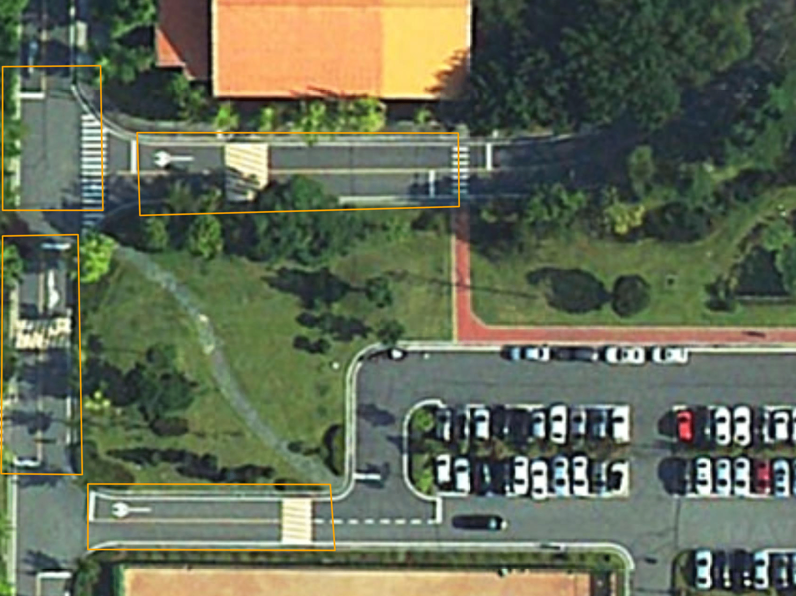
04
G
05
H
A
06
B
C
D
E
07
F

Slide 4
B
04
05
C
06
A
D
07
E

Slide 5
TrackEvent: JSoN Format
카메라 식별자
{
“node”: “etri:04”,
“track_id”: “1”,
“state”: “Confirmed”,
“location”: [387.79,649.97,732.72,947.65],
“frame_index”: 86,
“ts”: 1679886604539,
“world_coord”: [232852.4917711,420273.9575318],
“distance”: 11.313,
“zone_relation”: “E(C)”
}
영상내 tracklet 식별자
영상내 bbox 좌표
millis (UTC)
실세계 좌표 (EPSG:5186)
카메라부터의 거리 (m)
물체 위치와 zone과의 관계
U, E(Z), I(Z), L(Z), T(Z)

